Slide 1
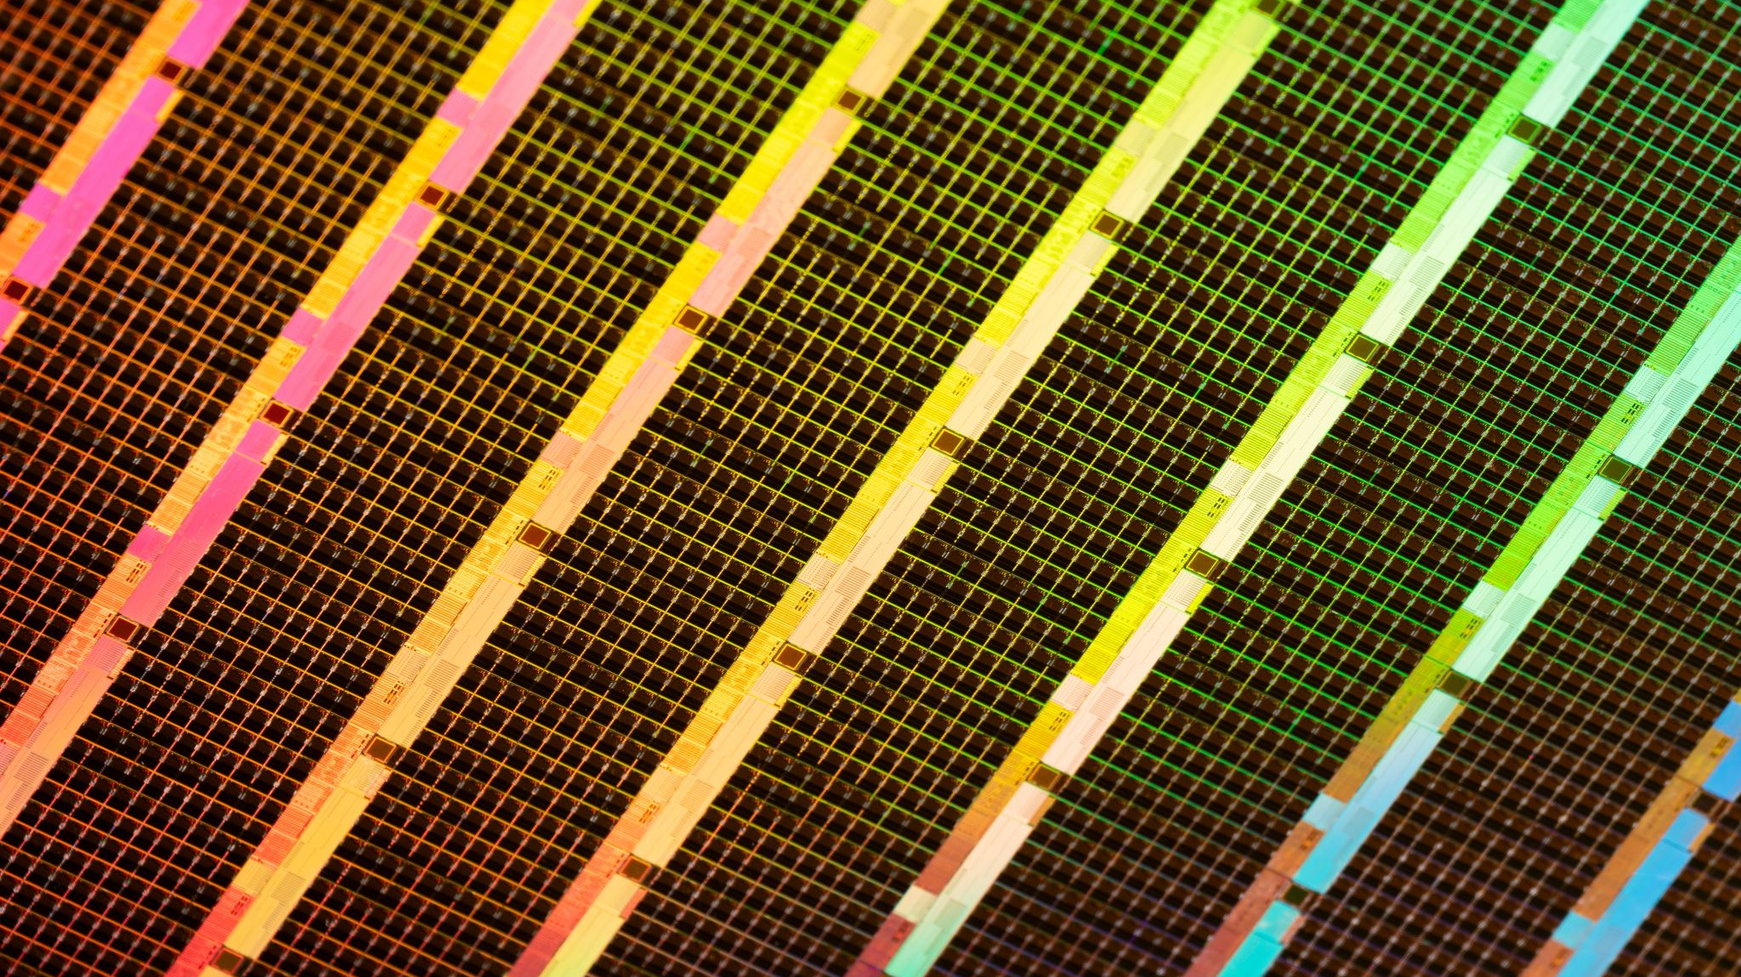
Modular Heater Instrument
Sean Kim
2025 Summer
UMD Sensors Actuators Lab

Slide 2
Overview
Introduction
Proposed solution
Results from the prototype
Future works
Reflection

Slide 3
Introduction
Goal: using photonic sensors for gas sensing
Photonic sensors & temperature:
Material refractive index and resonance wavelengths shift with temperature
Causes optical drift
Gas sensing performance & temperature:
Affects baseline stability, sensitivity, and selectivity
Leads to inaccurate or unreliable measurements without calibration
Issue at hand: No test setup/tool to evaluate sensor behavior at varying temperatures

Slide 4

Goals
Heating System:
Enable homogeneous gas and sensor heating with controllable temperature
Power simultaneously from single power source
Improve components and electronics of Rafa’s system
Flow Control:
Create a system to easily control multiple gas flow rates using MFCs
Allow safety checks for flow-rate controllers
LabVIEW Interface:
Indicate temperature & pressure changes
Develop easy-to-use interface

Slide 5
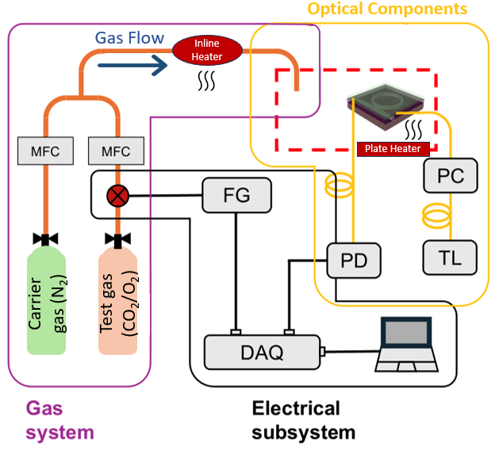
Experimental Design
Desired Constraints:
Max flow rate of 5L/min
Gases: CO2, O2, N2
Temp of gas:
Max: 50 C
Min: 25 C
Increments of 5

Slide 6

Proposed solution
Three Part Solution:
Create UI system for MFC
Prototype modular heater
Design long-term PCB heater

Slide 7
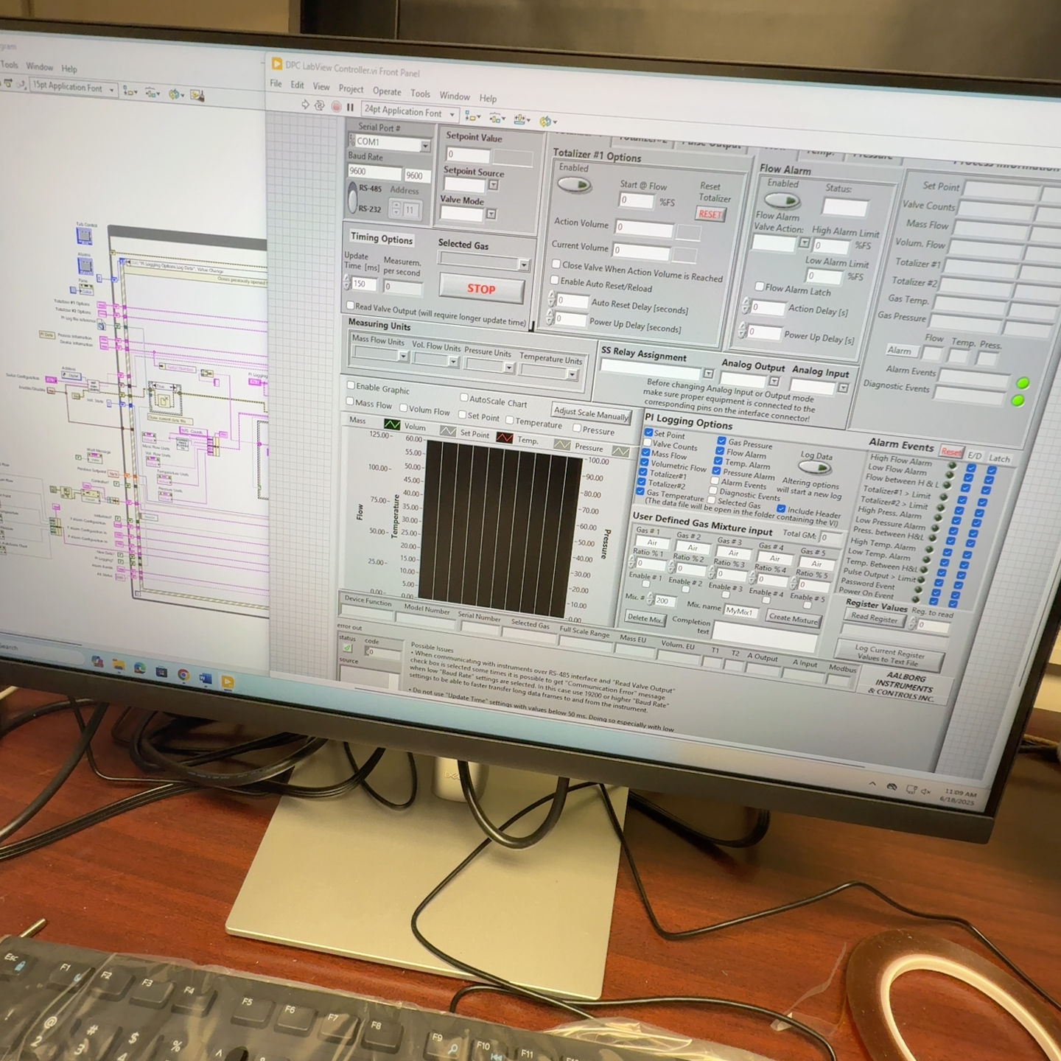
1. LabVIEW MFC UI

Slide 8
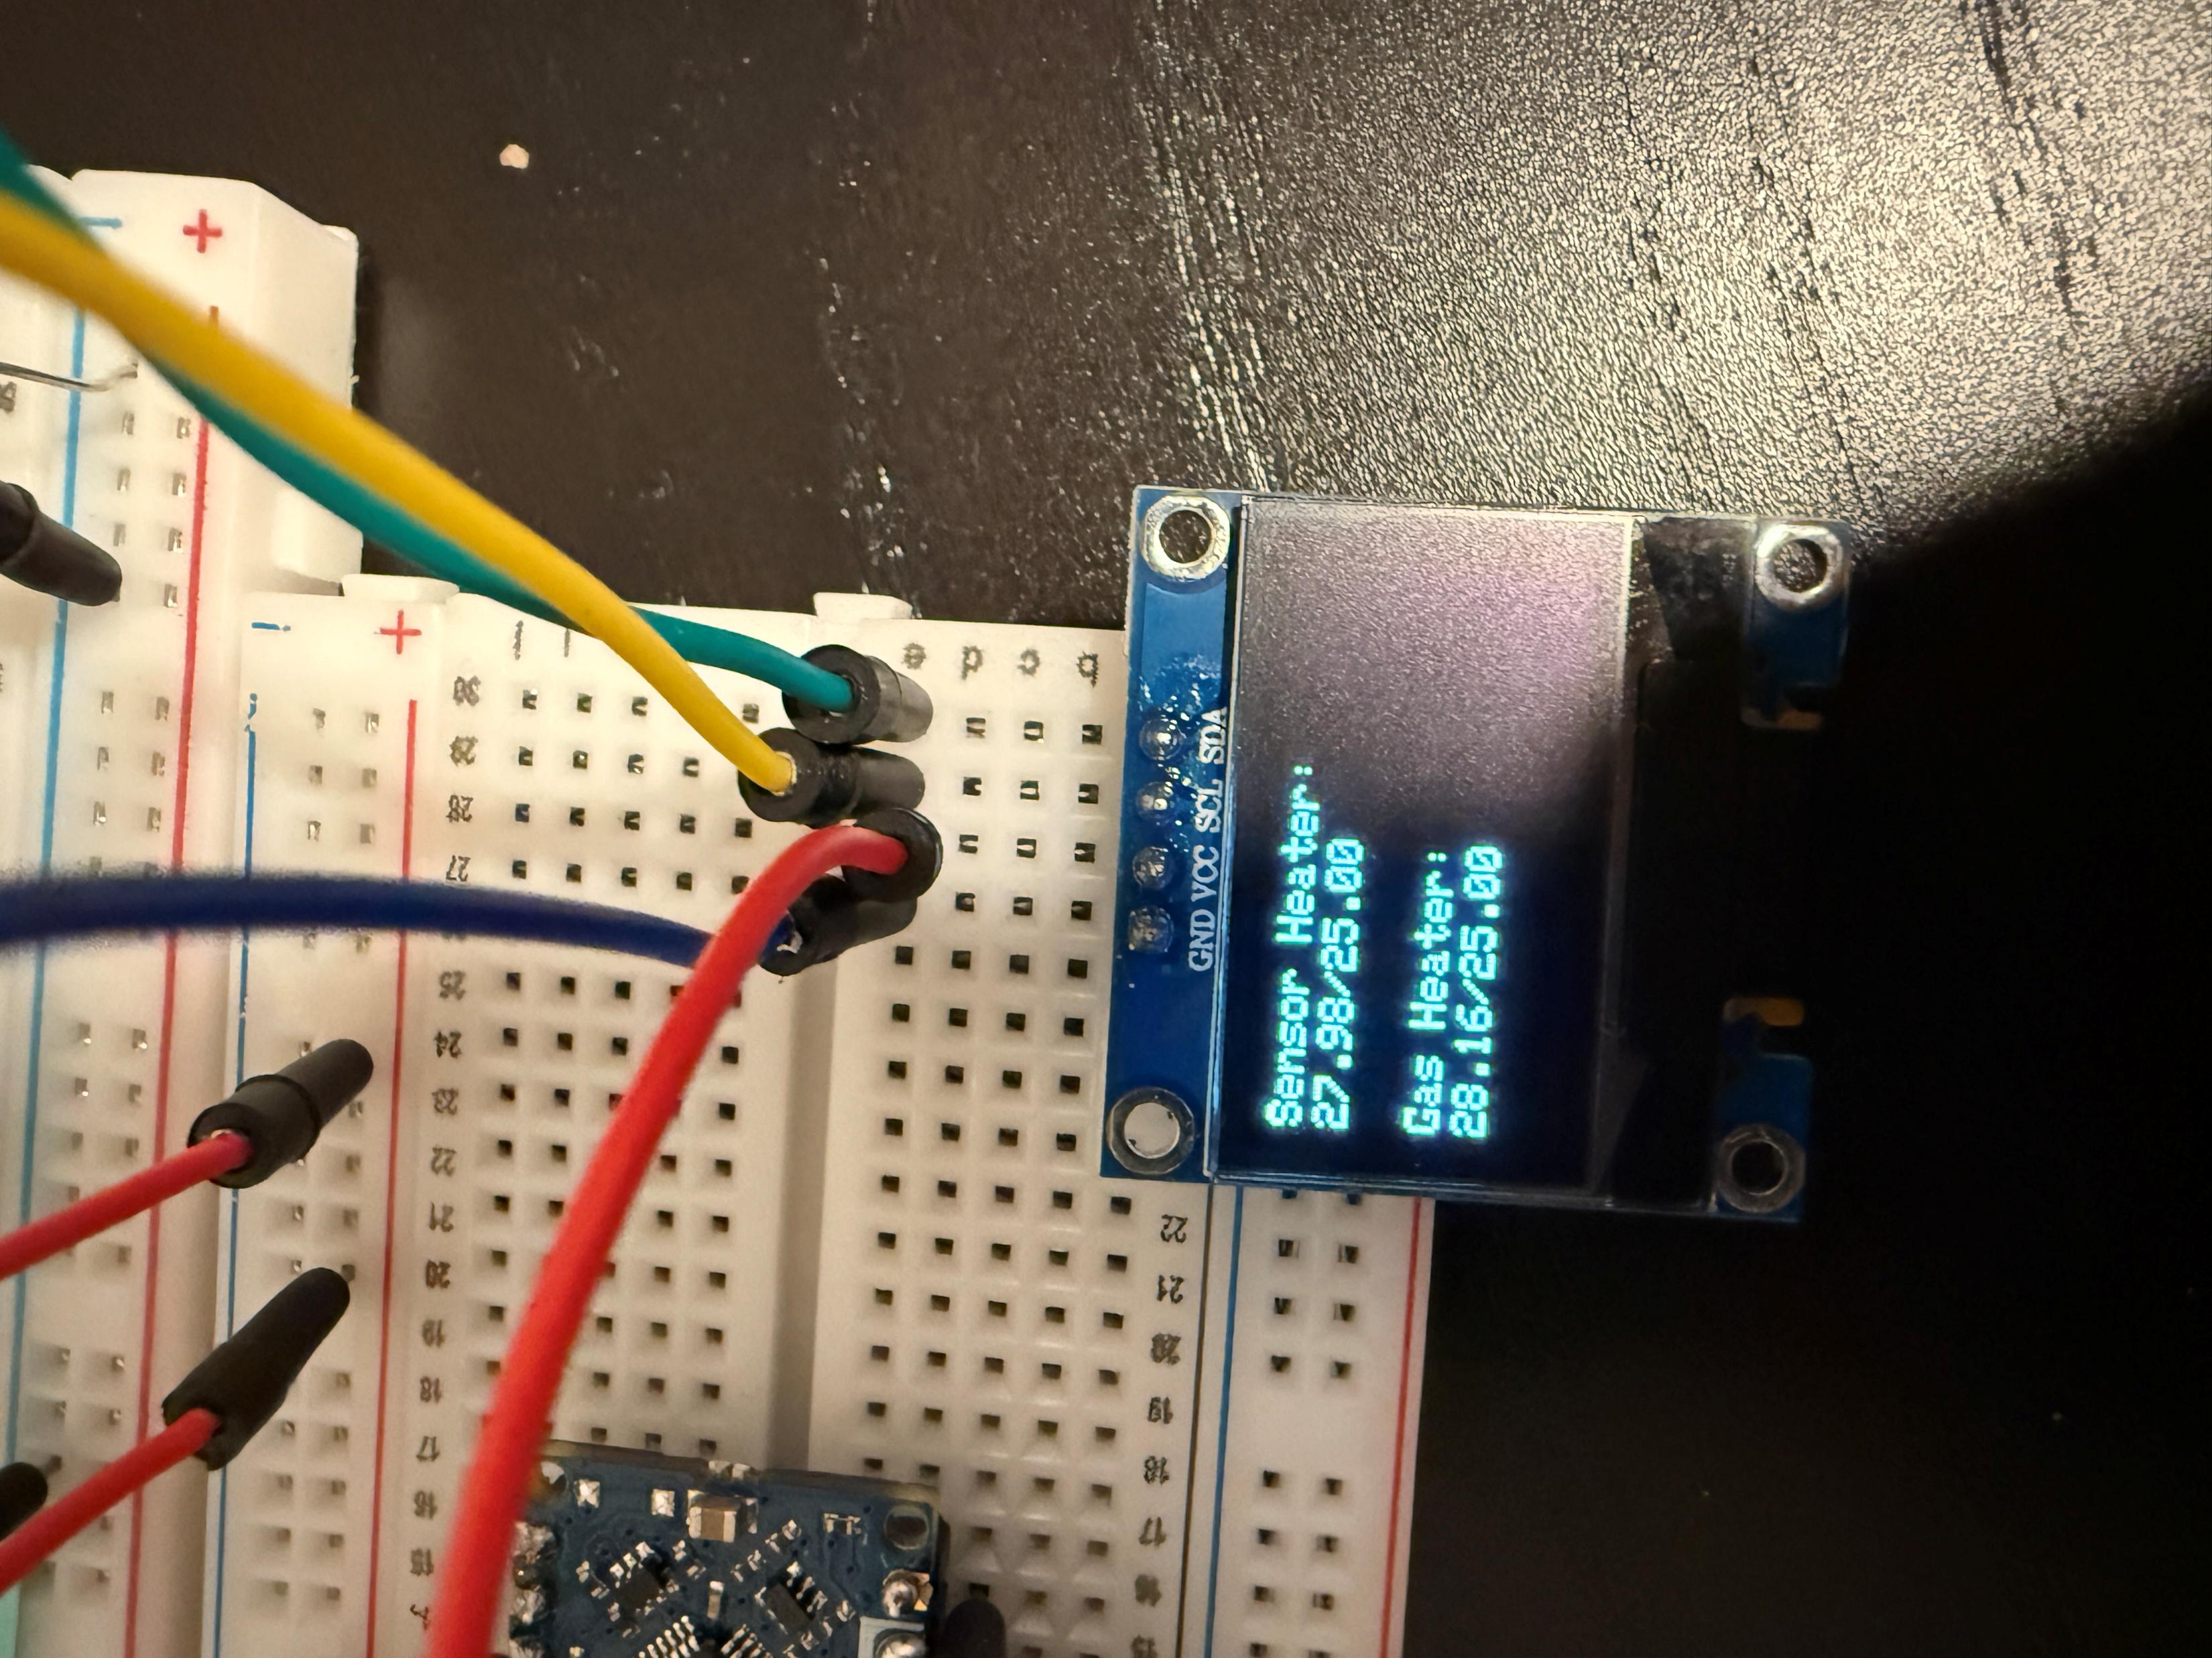
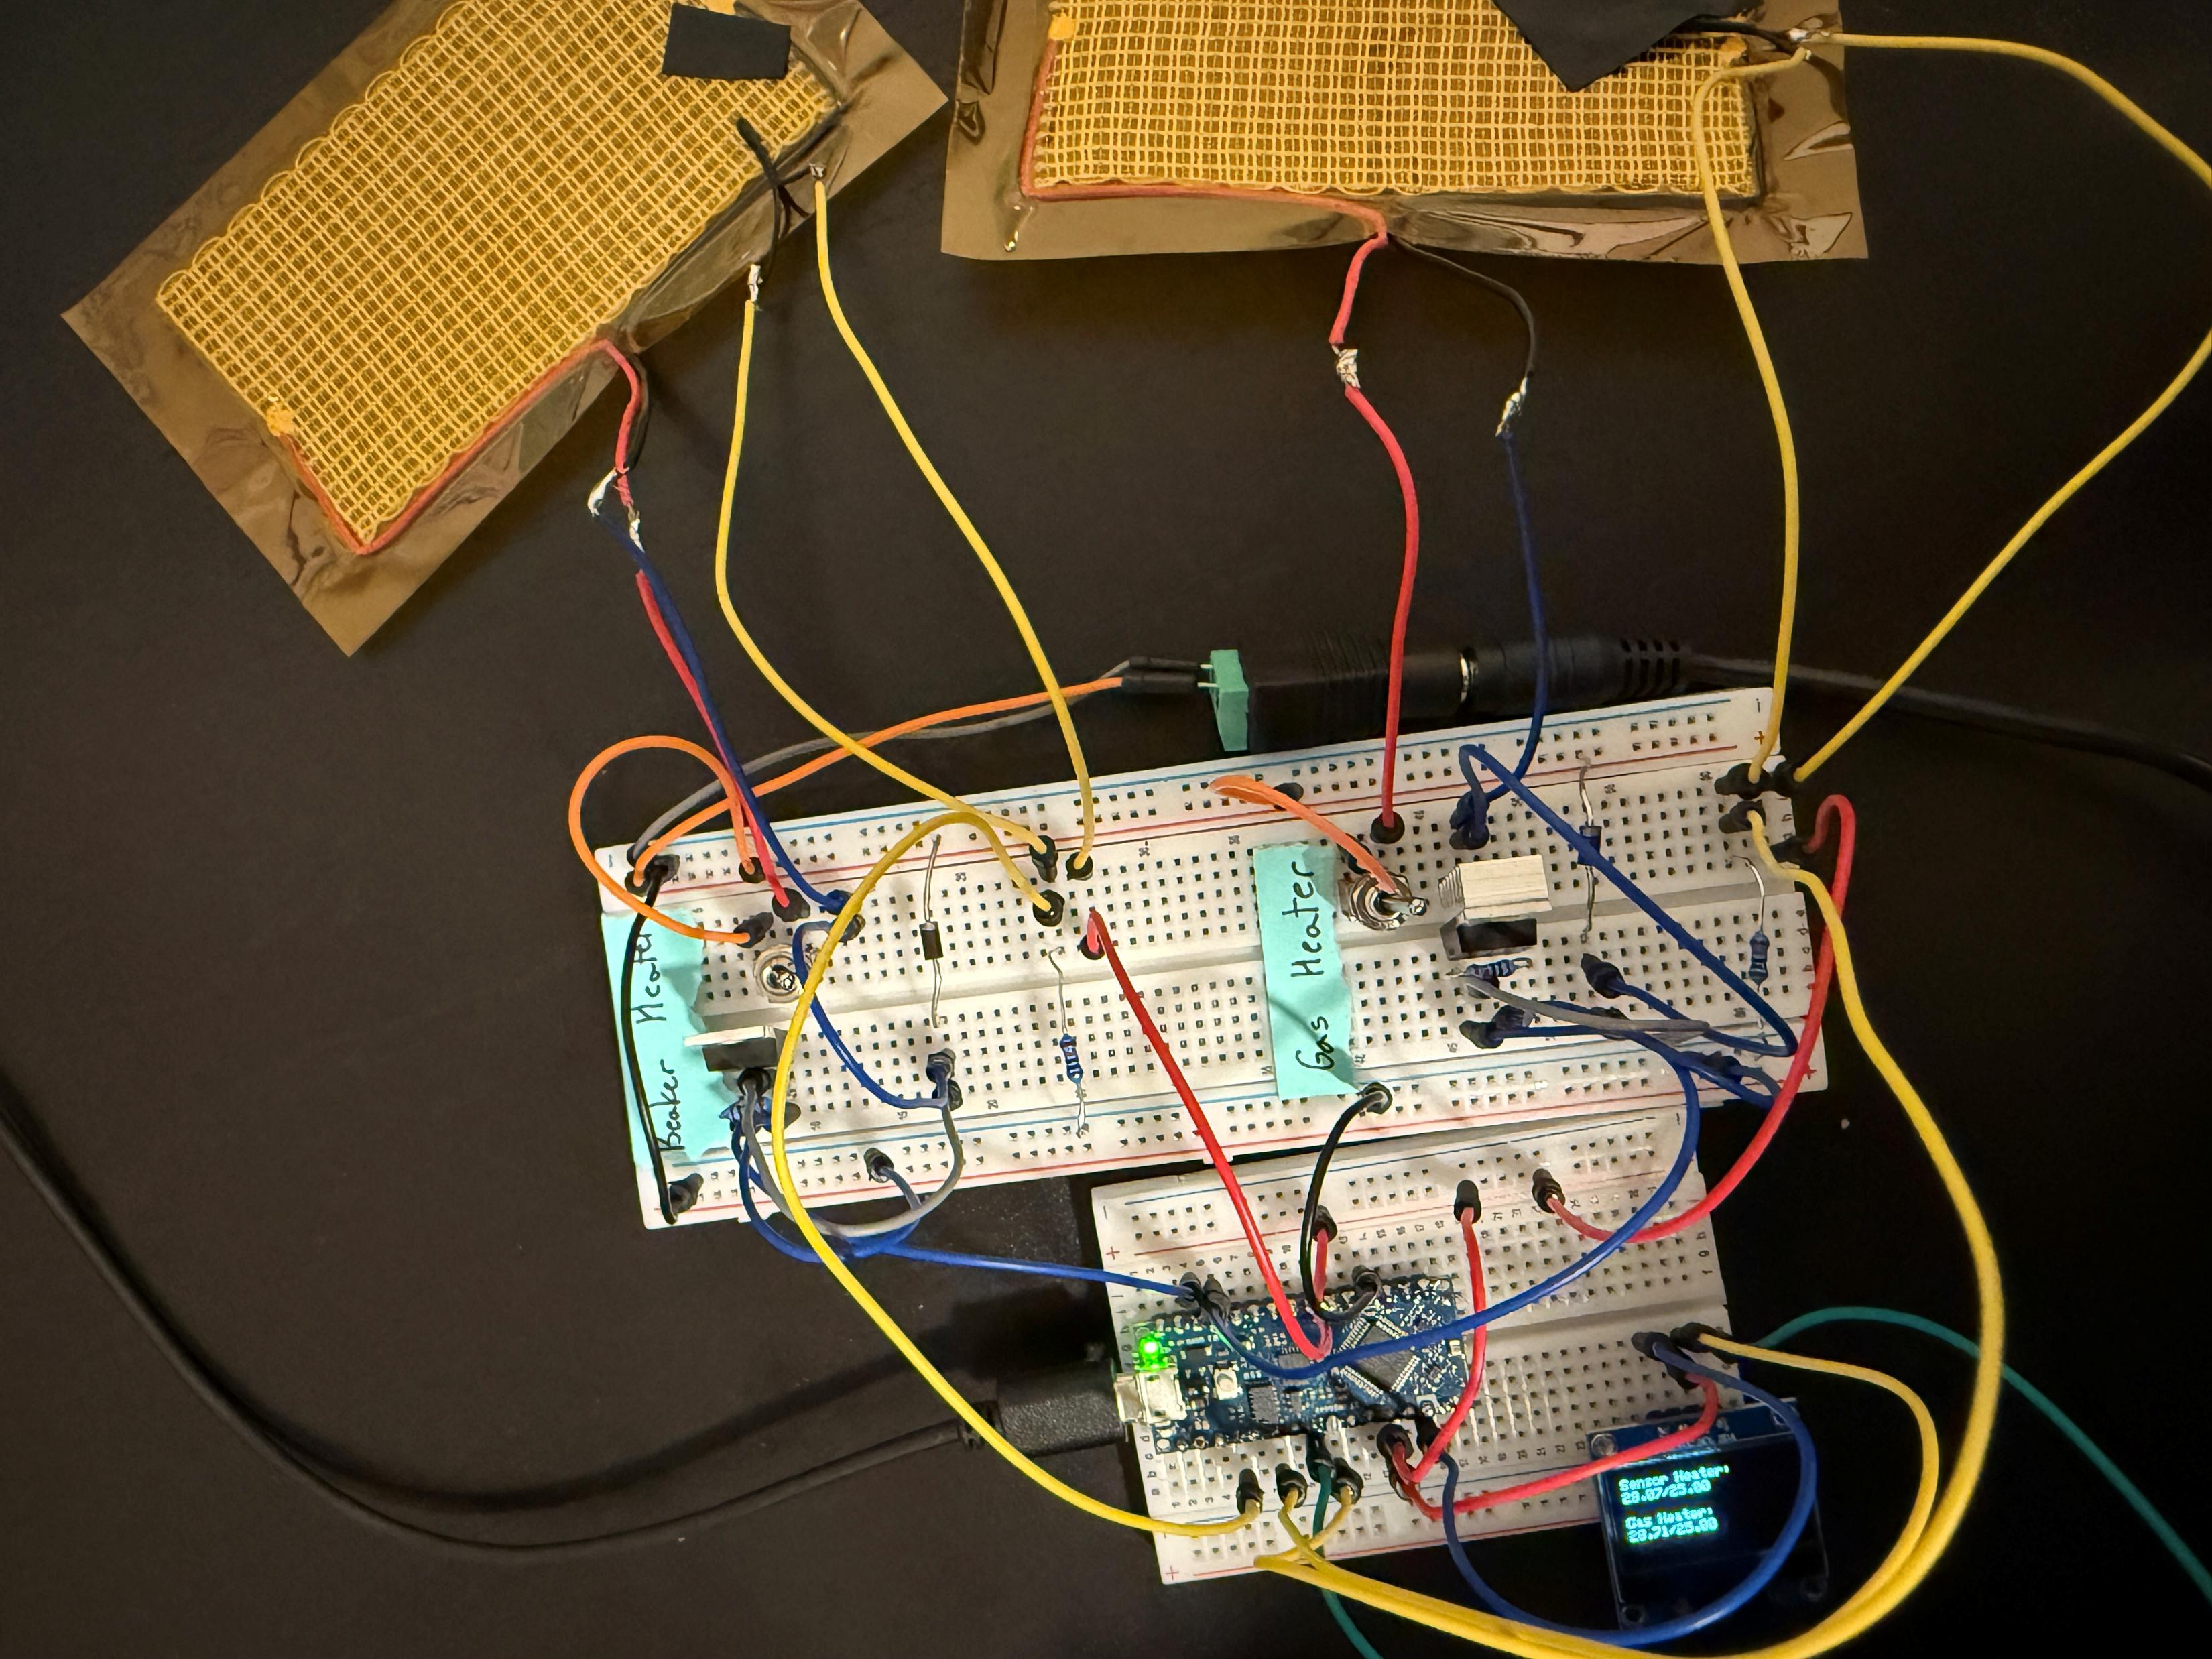
2. Prototype Modular Heater

Slide 9
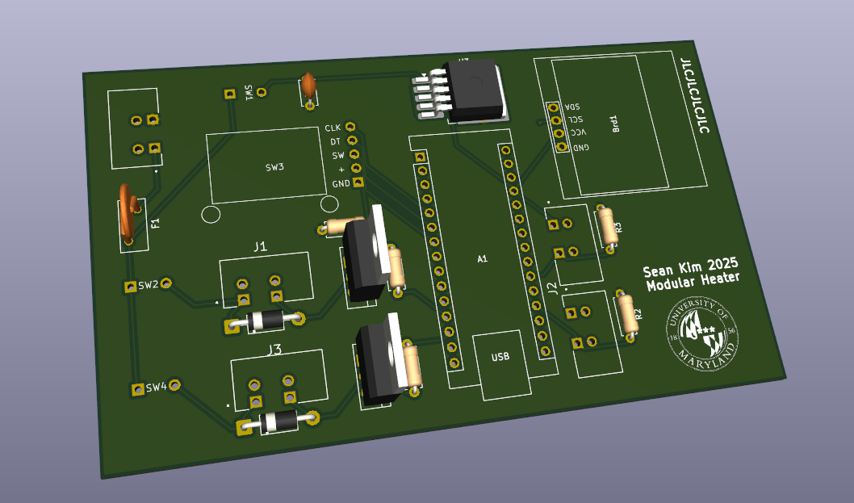
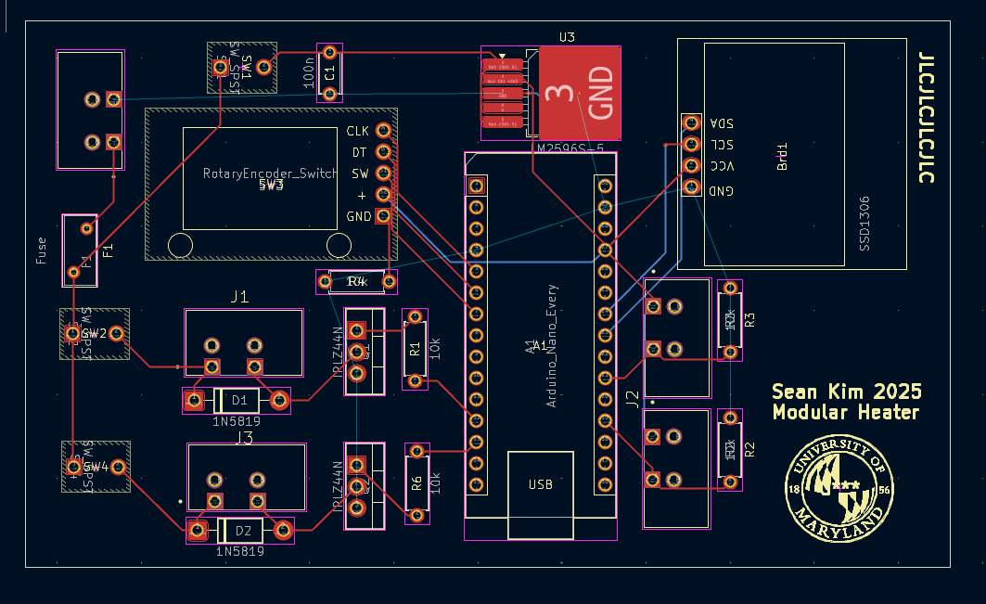
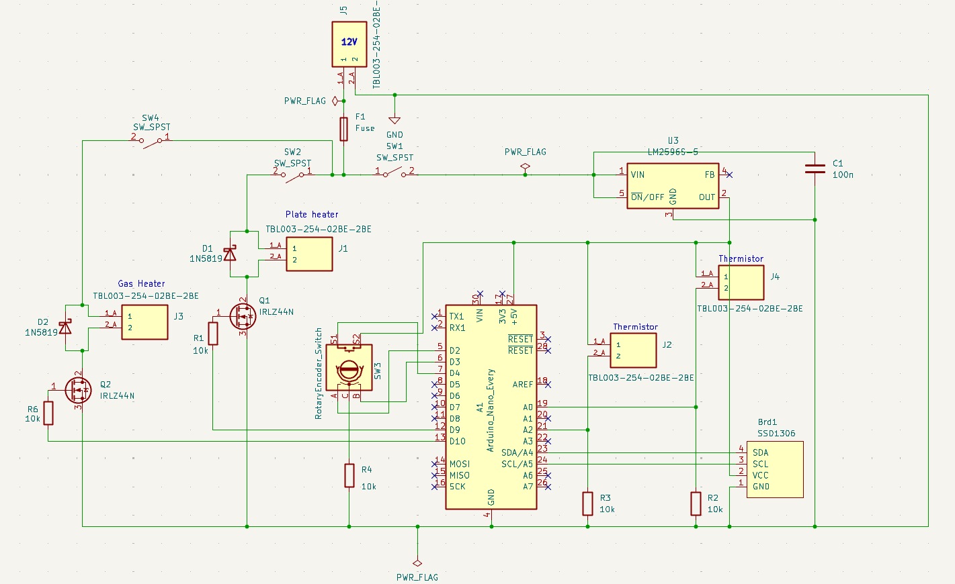
3. Long-term Modular Heater
KiCad

Slide 10
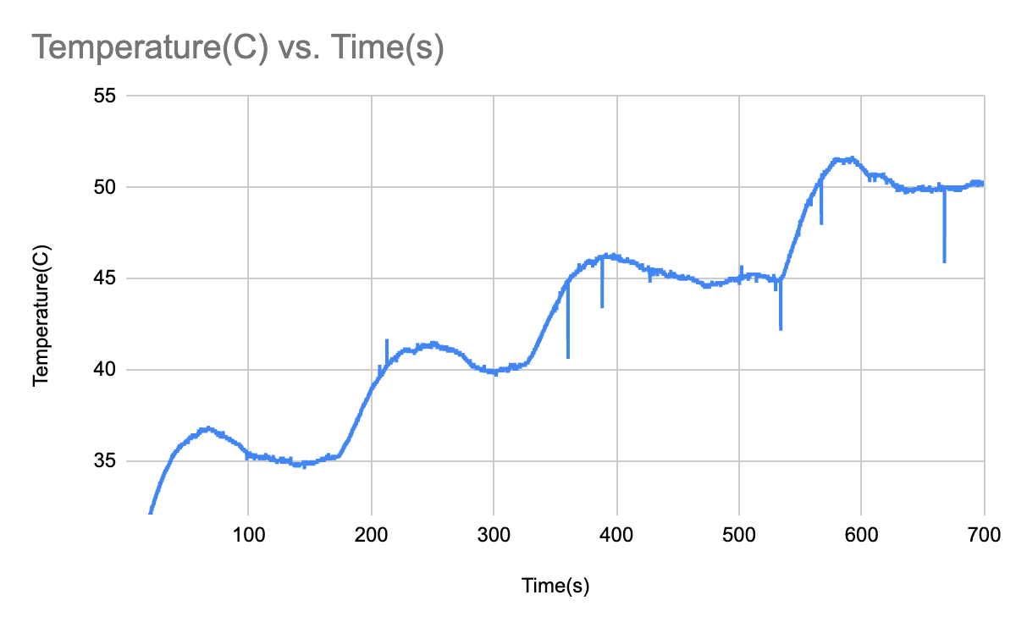
Heating Curve

Slide 11
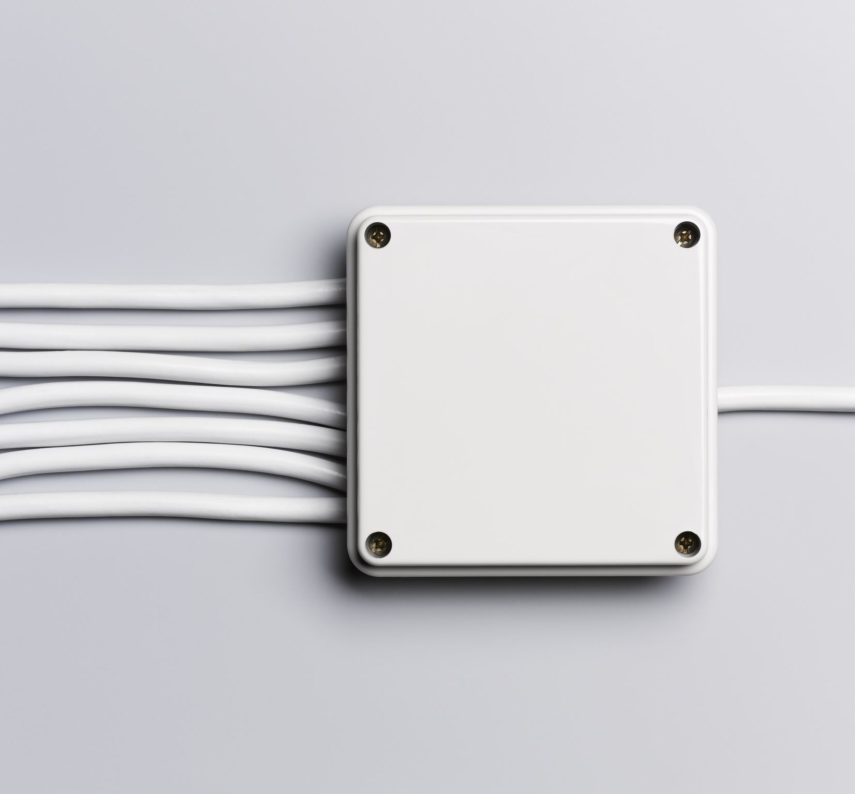
Future works
Heater Control Improvements
Add rotary encoder to switch between two heater setpoints
Consolidate power lines → single input voltage
Optimize PID algorithm
Sensor Enclosure Component
Insulated chamber to contain heat (only inlets)
Easy-to-open lid for setup

Slide 12

Challenges
Independent learning
Integrating hardware and software
Prototyping with limited resources
Documenting design procedure

Slide 13

Skills Learned
Programming & Control:
Data-flow programming (LabVIEW)
PID control
Hardware Desing & Prototyping:
Circuit & PCB design
Component sourcing
Breadboarding & soldering
Optimization & Documentation
Power optimization
Product documentation

Slide 14

Acknowledgements
Dr. Miao Yu
Bibek
Rafa

Slide 15

Thank You

